Slide 1

Outline
WIFI Security and
Attacks
INSE 6120 - Cryptographic Protocols and Network Security
Presented to:
Professor Ivan Pustogarov
Presented by:
Kartik Sahu- 40224524
Pooja Polampalli-40217185​
Syeda Maria Anjum-40216612
Viraj Bhanushali- 40222104

Slide 2
Index
Introduction
Stream Ciphers
How Does the WEP Encryption Work?
Vulnerabilities in WEP
How the attack works?
Implementation of attack
How WPA overcomes WEP shortcomings

Slide 3
WEP – An Introduction
Wireless Equivalent Privacy (WEP) is an early Wi-Fi encryption standard that was first used in 1997 as part of the original IEEE 802.11 wireless network protocol. WEP was made to protect the privacy and integrity of data sent between Wi-Fi devices by giving them the same level of security as wired networks. Its main goal was to stop unauthorized access and eavesdropping on wireless networks. As Wi-Fi technology became more popular, people became more worried about their privacy and safety.
WEP uses the RC4 stream cipher to encrypt data and the Cyclic Redundancy Check (CRC-32) to make sure that the data is correct. But as time went on, flaws and weaknesses in the way WEP was made were found, which made it useless in the end. WEP was the first widely used encryption standard for Wi-Fi networks, but it is now considered to be out of date and unsafe. This introduction will give an overview of WEP's history, how it worked, and why it was eventually replaced by stronger security protocols.

Slide 4
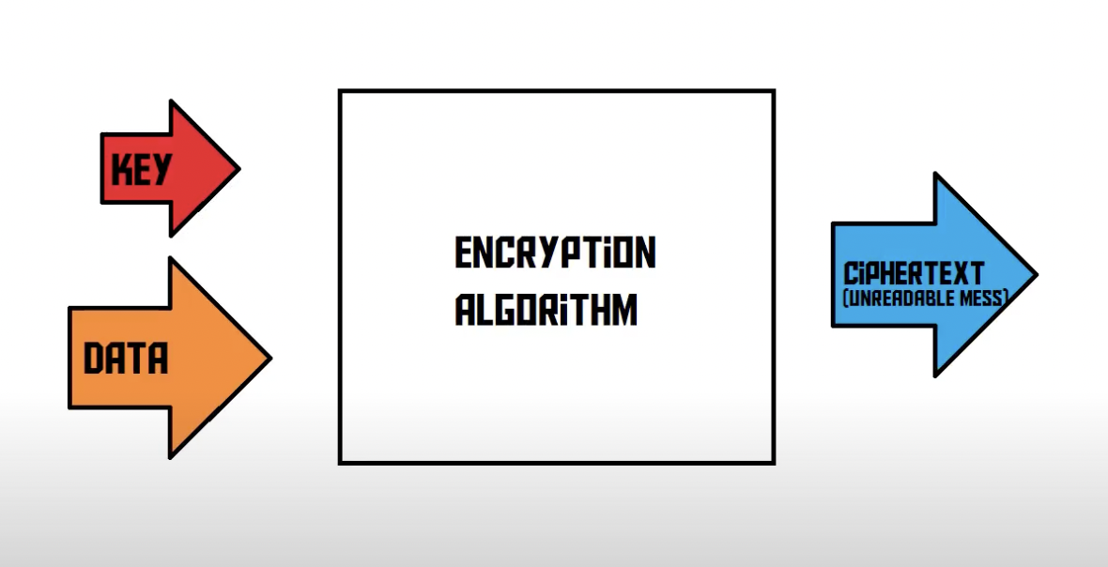
Stream cipher
Notes:
Encryption is anything that takes the plain text and a key to convert the plaintext into ciphertext This cipher text can again be converted into plaintext

Slide 5
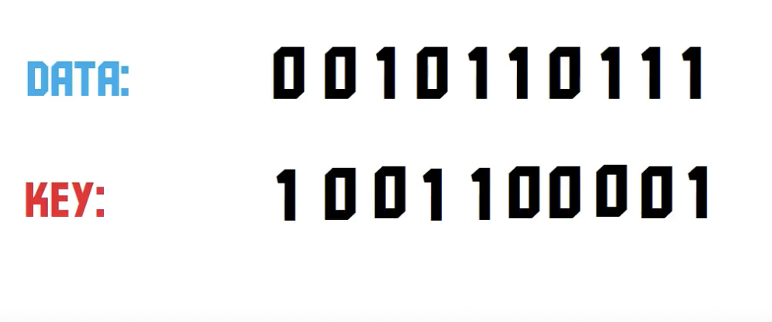
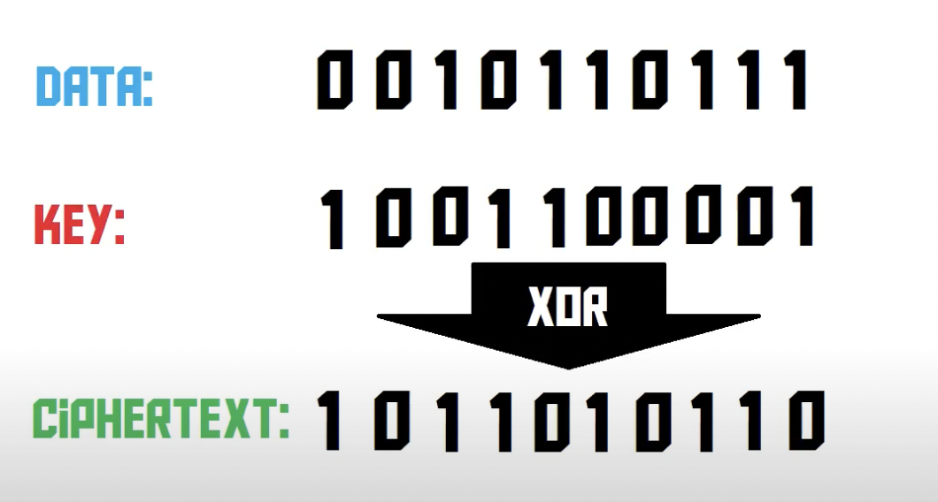
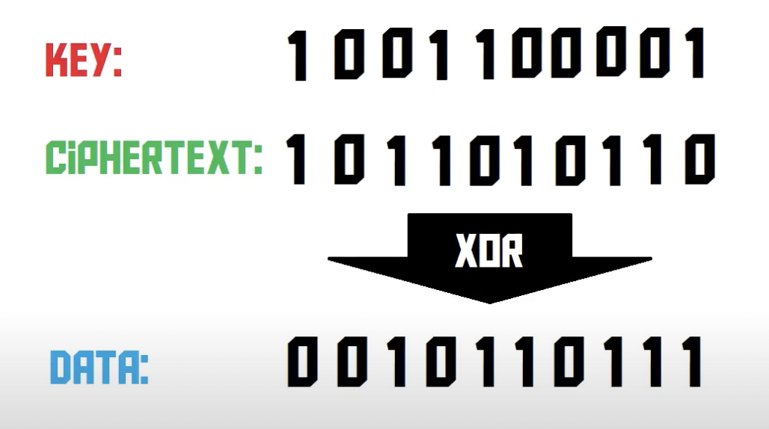
Stream Cipher (Cont.)
Notes:
In stream cipher the key size should be same as the plain text size.
In real word it is practical to have a key size same as plaintext So we use a small key and a random number generator Problem here is that random number generator offered by most programming languages are predictable and can are vulnerable to replay attacks.

Slide 6
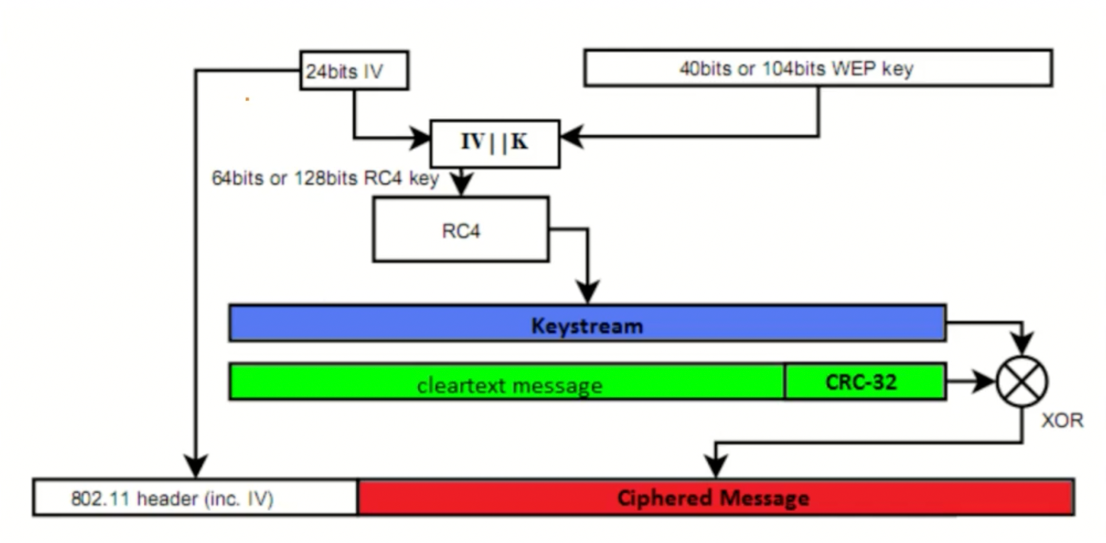
How does WEP encryption work?

Slide 7
Vulnerabilities in WEP
WEP (Wired Equivalent Privacy) was the first security protocol introduced for wireless networks, but it had several shortcomings that made it vulnerable to various types of attacks.
Weak encryption: Attackers can exploit WEP's RC4 stream cipher's vulnerabilities. WEP's static key and poor key management make RC4 weak.
Initialization Vector (IV) reuse: WEP encrypts data with a shared secret key and a 24-bit IV. In busy networks, 24-bit IVs are reused because they are too small. This allows attackers to gather enough encrypted packets with the same IV for statistical attacks and key recovery.
No key management: WEP does not allow automatic key distribution or rotation, so the same static key is used for long periods. As a key is used longer, it becomes easier to crack, making the network more vulnerable to attacks.
Lack of data integrity: WEP's CRC-32 checksum algorithm is linear and easily reversible, making it insecure. This allows bit-flipping attacks-attackers to alter data packets in transit without being detected.
No user authentication: WEP's shared secret key authentication is weak. If they get the shared key, unauthorized users can join the network easily.
Brute-force attacks: With enough encrypted packets with reused IVs, attackers can brute-force the WEP key due to weak encryption and key management.
Wi-Fi Protected Access (WPA) and WPA2 were developed in response to the vulnerabilities in WEP; these protocols offer stronger encryption, key management, and data integrity than WEP.

Slide 8
How does this hack work?
WEP (Wired Equivalent Privacy) is an old wireless security protocol that is easily broken.
WEP uses the RC4 encryption algorithm to encrypt packets sent between the router and client devices.
Each packet has a unique keystream generated using a 24-bit Initialization Vector (IV) that is sent in plain text.
The weakness of WEP is the short and repeating IV, which makes it vulnerable to statistical attacks.
Aircrack-ng is a tool used to determine the keystream, and with enough repeated IVs, it can crack WEP and provide access to the network.

Slide 9
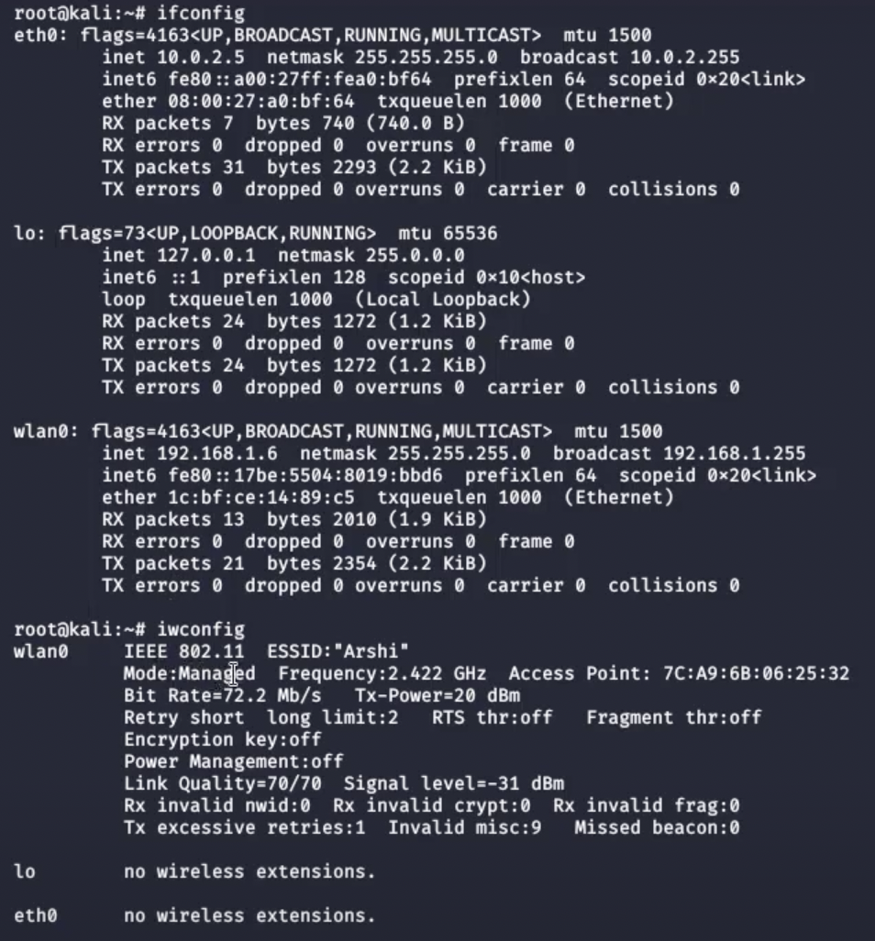
Implementation
Notes:
Shows the available network interfaces

Slide 10
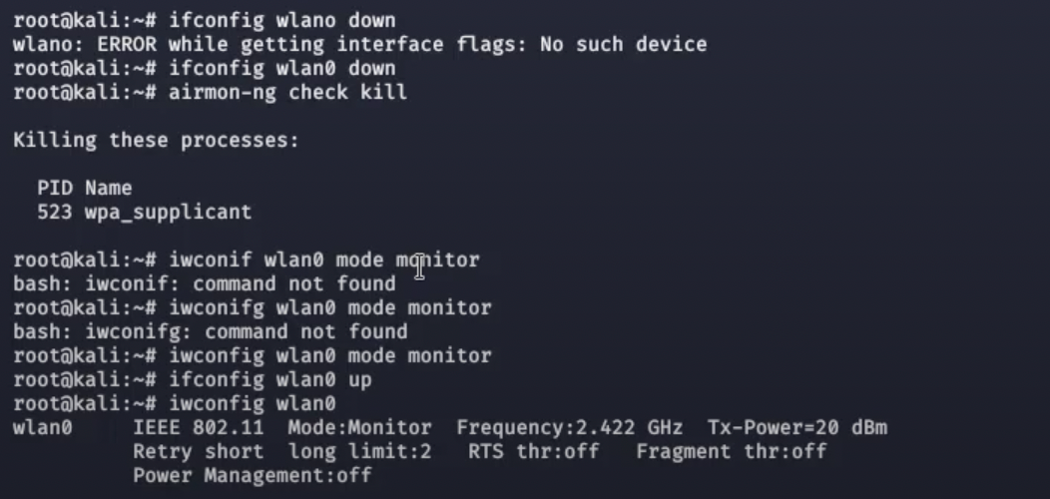
Implementation (Cont.)

Slide 11
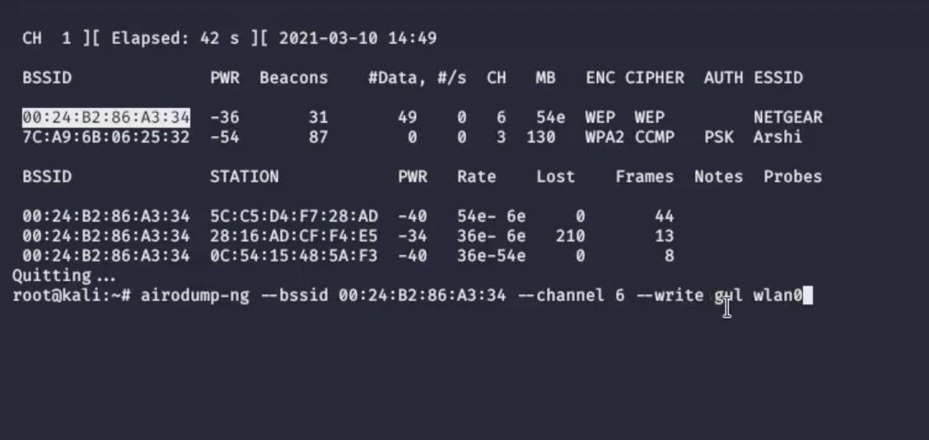
Implementation (Cont.)

Slide 12
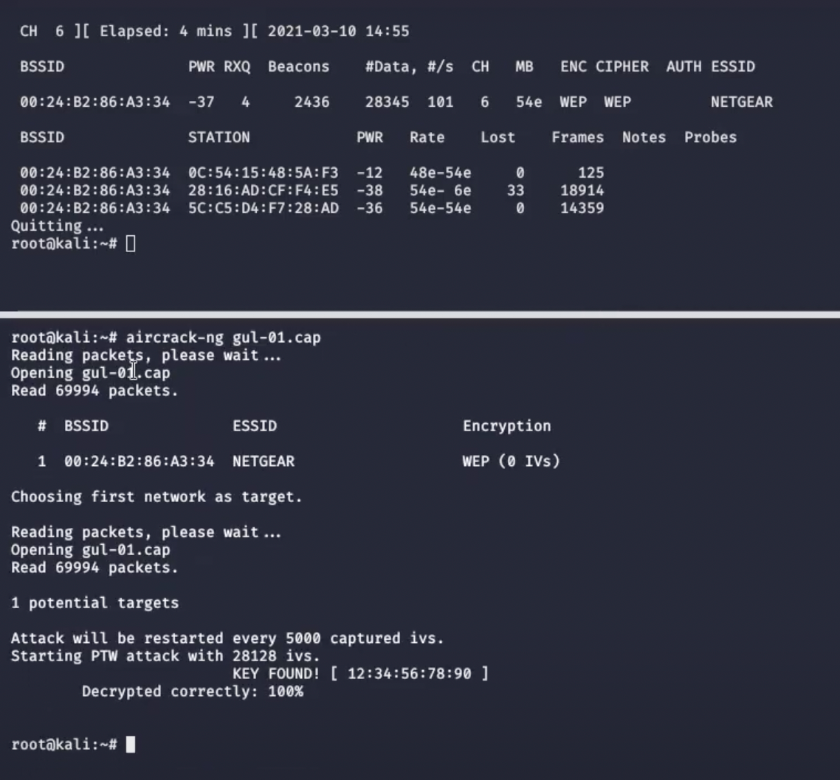
Implementation (Cont.)

Slide 13
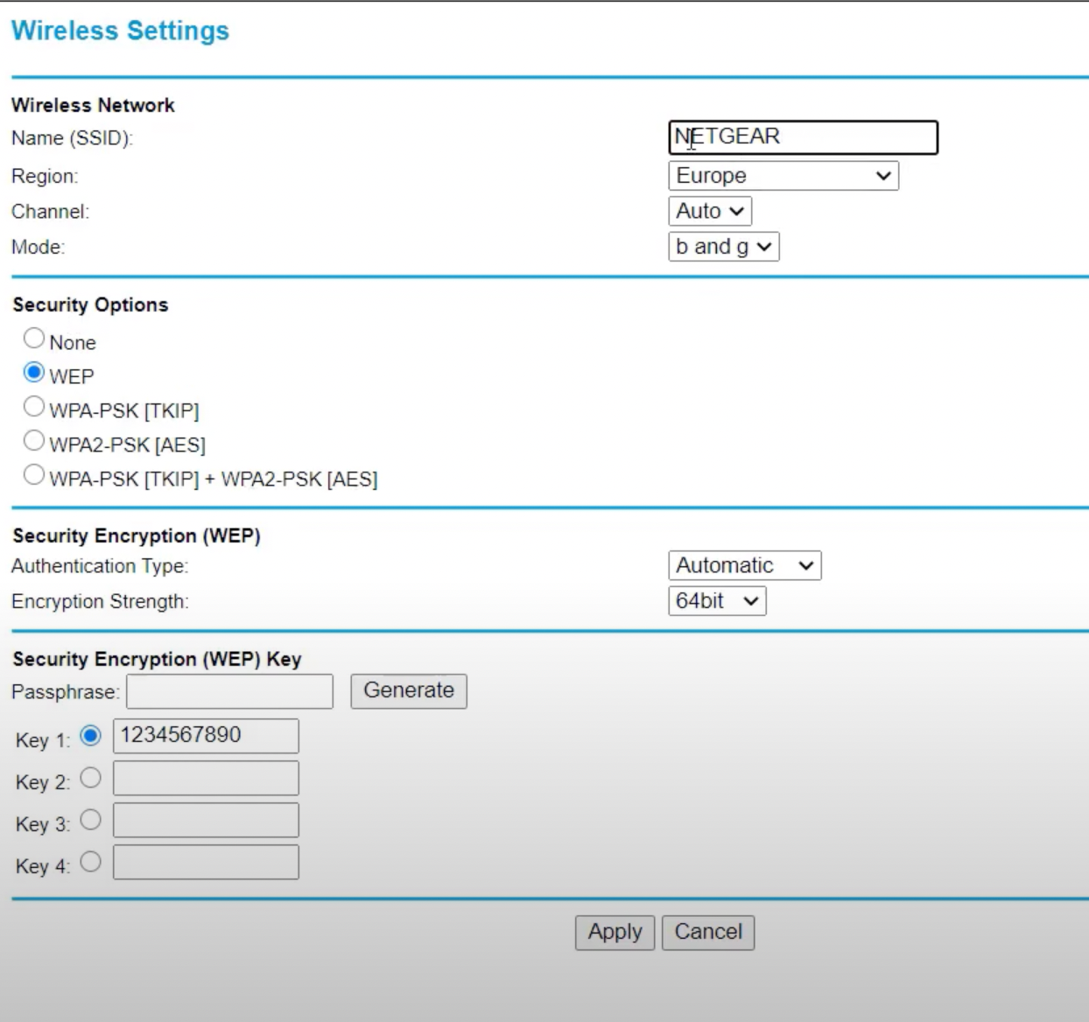
Implementation (Cont.)

Slide 14
How WPA fixed the shortcomings of WEP?
The Wired Equivalent Privacy (WEP) protocol had flaws, so WPA was created. WPA was created to address WEP's shortcomings while waiting for WPA2. WPA made several WEP improvements:
Stronger encryption: WPA uses the Temporal Key Integrity Protocol (TKIP) encryption protocol, which is much stronger than the encryption used in WEP. TKIP constantly changes the encryption keys to make it difficult for attackers to crack them.
Authentication: WPA uses a more secure authentication method called 802.1x authentication, which requires users to provide a unique login credential before they can connect to the wireless network. This prevents unauthorized users from accessing the network.
Key management: WPA uses a more sophisticated key management system that automatically generates and distributes keys to devices on the network. This makes it easier to manage and secure the network.
Message Integrity Check: WPA uses Message Integrity Check (MIC), which provides protection against attacks that alter the data being transmitted, such as packet injection attacks. MIC ensures that the data being transmitted has not been tampered with.
Robust security protocols: WPA includes several security protocols such as Message Integrity Check (MIC) and the Counter Mode with CBC-MAC Protocol (CCMP) that help protect against attacks such as replay attacks and message forgery.
Overall, WPA has significantly improved the security of wireless networks compared to WEP. It is important to note that newer and more secure wireless security protocols such as WPA2 and WPA3 have since been developed to further enhance wireless network security.

Slide 15
Thank You!

